Slide 1


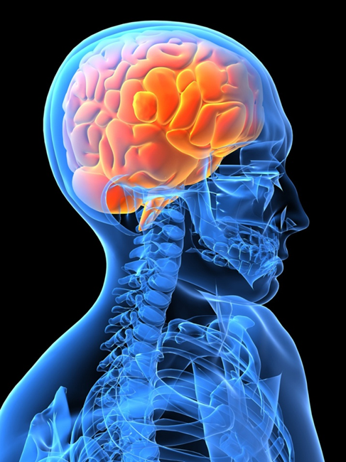
Brain Tumor Detection Using Image Segmentation
Bangalore Institute of Technology
K.R. Road, V V Puram, Bangalore-560004
Department of Electronics and Communication Engineering
PRESENTED BY:
GUIDED BY:
Yuvraj Singh (1BI19EC170)
Shubham Kumar (1BI19EC138)
Ankush (1BI18EC015)
Dr. A M Vijaya Prakash
Professor, Dept. of Electronics & Communication

Slide 2
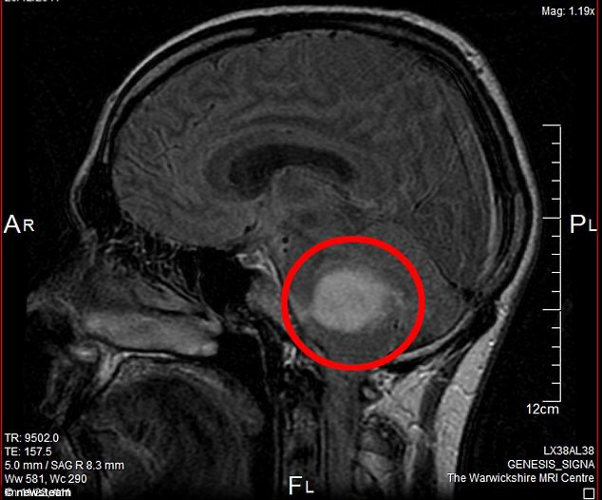
ABSTRACT
Brain tumor can be classified into two types: benign and malignant. Timely and prompt disease detection and treatment plan leads to improved quality of life and increased life expectancy in these patients. One of the most practical and important methods is to use Deep Neural Network (DNN). In this paper, a Convolutional Neural Network (CNN) has been used to detect a tumor through brain Magnetic Resonance Imaging (MRI) images. Images were first applied to the CNN. The accuracy of Softmax Fully Connected layer used to classify images obtained 98.67%. Also, the accuracy of the CNN is obtained with the Radial Basis Function (RBF) classifier 97.34% and the Decision Tree (DT) classifier, is 94.24
Bangalore Institute of Technology
Dept. of ECE, BIT

Slide 3
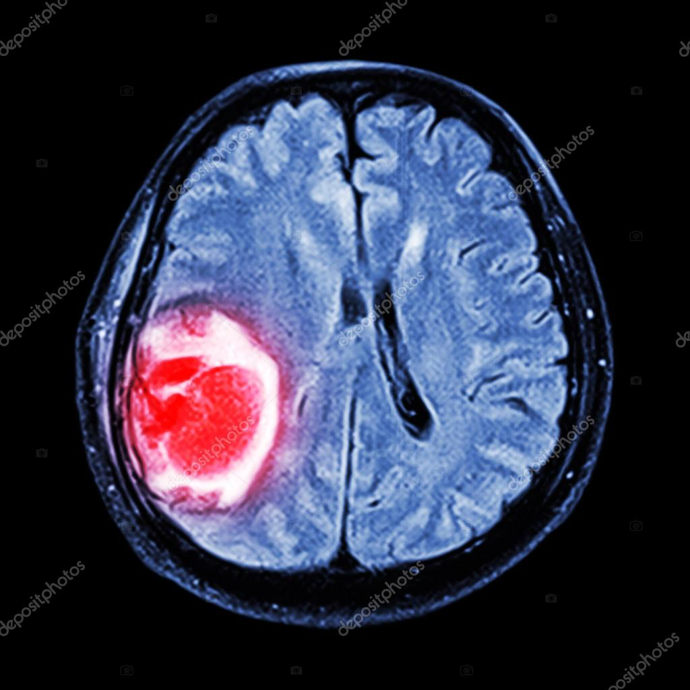
In addition to the accuracy criterion, we use the benchmarks of Sensitivity, Specificity and Precision evaluate network performance. According to the results obtained from the categorizers, the Softmax classifier has the best accuracy in the CNN according to the results obtained from network accuracy on the image testing. This is a new method based on the combination of feature extraction techniques with the CNN for tumor detection from brain images. The method proposed accuracy 99.12% on the test data. Due to the importance of the diagnosis given by the physician, the accuracy of the doctors help in diagnosing the tumor and treating the patient increased.
ABSTRACT
Bangalore Institute of Technology
Dept. of ECE, BIT

Slide 4
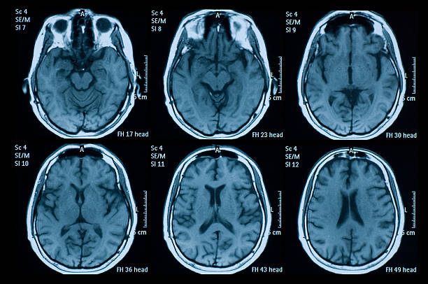
ABSTRACT
MRI SCAN OF HUMAN BRAIN
Bangalore Institute of Technology
Dept. of ECE, BIT

Slide 5
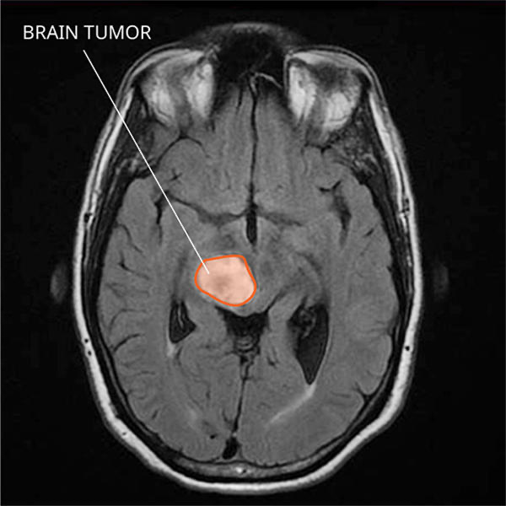
ABSTRACT
IMAGE DEPICTING BRAIN TUMOR
Bangalore Institute of Technology
Dept. of ECE, BIT

Slide 6
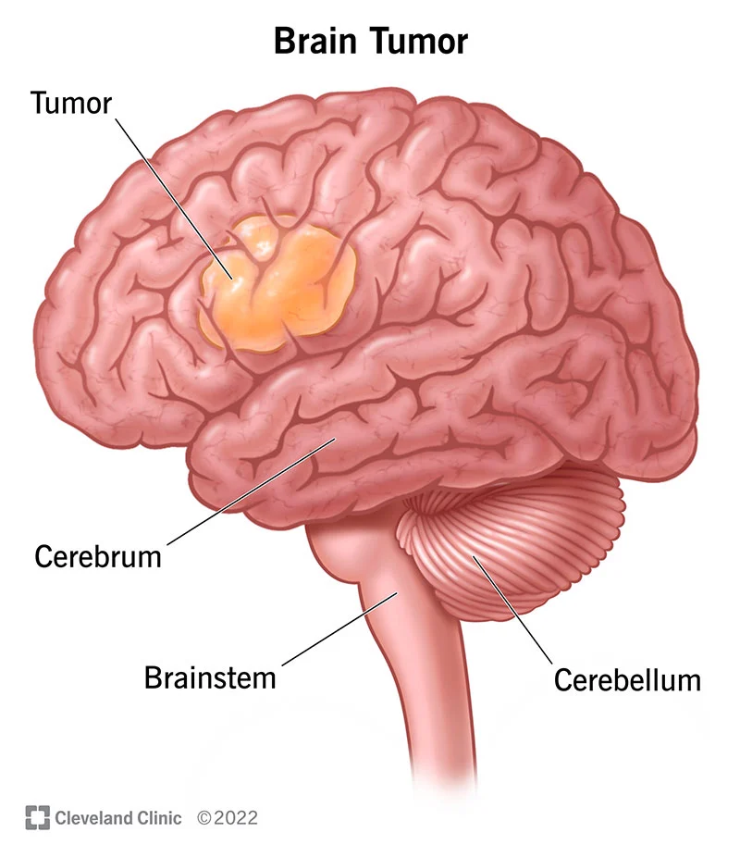
What is a Brain Tumor ?
INTRODUCTION
A collection of abnormal cells that grows in the brain or central Spine canal, One abnormal cell becomes two, two becomes four, four becomes eight,until there is a lump of abnormal cells.
There are 2 types of Brain Tumor -
Primary Brain Tumor
Secondary Brain Tumor
Bangalore Institute of Technology
Dept. of ECE, BIT

Slide 7
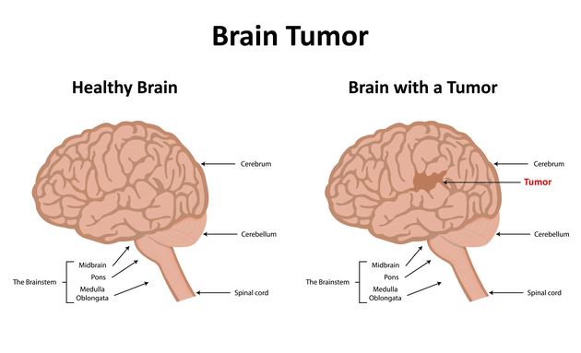

Slide 8
Primary Brain Tumors:
﻿﻿These tumors can be Benign or Malignant. Primary tumors originates in the CNS
﻿﻿Benign brain tumors do not contain cancer cells :
﻿﻿Usually, benign tumors can be removed and the rarely grow back. Benign brain tumors have an obvious border or edge.
﻿﻿They don't spread to other parts of the body They don't invade tissues around them However, benign tumors can press on sensitive area of brain and can cause serious health problems.
Unlike benign tumor of other parts of the body, benign tumor of the brain are sometimes life threatening. with time benign brain tumors can become malignant.
INTRODUCTION
Bangalore Institute of Technology
Dept. of ECE, BIT

Slide 9
Malignant brain tumors (Also called Brain Cancer) contain cancer cells:
﻿﻿More serious and often are threat to life
﻿﻿Rapid Growth
﻿﻿Invade or crowd nearby healthy brain tissue Cancer cell may spread to other parts of the brain or to the spinal cord
﻿﻿rarely spread to other parts of the body.
INTRODUCTION
Bangalore Institute of Technology
Dept. of ECE, BIT

Slide 10
Secondary brain tumors also called as Metastatic Brain Tumor originates from malignancies outside of the CNS and spread to the brain, typically through arterial circulation.
﻿Approx. 25% of individual with systemic cancer develop metastatic brain tumor approx. 80% in cerebral hemisphere and 20% in the posterior fossa.
﻿1/3rd of bin metastases originate in lungs and followed in manner below in order of frequency : Lungs->Breast-›Skin-›GI tract-›Kidney
﻿Frontal lobe is the most common site
﻿Average survival with the treatment is approx. 6 months but varies widely by the extent of other systemic metastases.
INTRODUCTION
Bangalore Institute of Technology
Dept. of ECE, BIT

Slide 11
LITERATURE SURVEY
Paper Title | Author And Year | Methodologies | Limitations
Brain Tumor Detection Using Deep Neural Network And Machine Learning Algorithm. | Masoumeh Siar and Mohammad Teshnehlab 9thInternational Conference On Computer Engineering (ICCKE 2019) | A new method based on the combination of feature extraction algorithm and the CNN for tumor detection from brain images is presented. | The accuracy of the CNN is obtained with the RBF classifier 97.34% and the DT classifier 94.24%.
Brain Tumor Segmentation Based On Deep Learning | Hajar Chergui,Jamal Riffi,Ali Yahyauy and Hamid Tairi LIIAN Laboratory ,2018 | Developed a fully automatic brain tumor segmentation method. Proposed a method based on deep learning, using deep convolution networks based on the U-Net model. | Method provided an efficient and robust segmentation compared to the manually delineated ground truth and showed a maximum dice similarity coefficient of 0.81 for the dataset used.
Brain Tumor Detection Using Deep Learning And Image Processing. | Aryan Sagar Methil International Conference On Artificial Intelligence And Smart Systems(ICAIS-2021) | Image Processing techniques helped us solve the illumination issues and brought the tumor into focus. Data augmentation was used to reduce the chances of overfitting | There are small chances that the image preprocessing applied can damage the information which makes a tumor image appear non-tumor in the eye of the CNN.
Bangalore Institute of Technology
Dept. of ECE, BIT

Slide 12
LITERATURE SURVEY
Brain Tumor Detection Using Deep Learning Algorithm. | Avigyan Sinha,Aneesh RP,Malvika Suresh,Abinaya D John Hopkins University,Baltimore, USA (2019) | System architecture of the proposed system components are image acquisition, pre- processing, segmentation, feature extraction and classification. | System can be improved to support with a web interface. Detection of different diseases can be also identified from the MRI images.
Multi Classification of Brain Tumor Images using Deep Neural Network | Hossam H.Sultan,Nancy M.Salem,Walid Al-Atabany Computer Aided medical diagnosis(25April,2019) | System starts to load and extract images and labels from datasets raw files and then make a preprocessing and augmentation techniques,followed by setting the hyper-parameters. | Proposed architecture has achieved the highest accuracy of 96.13% and 98.7% concerning the two datasets used in this paper.
Brain Tumor Detection Using Deep Learning Models. | Sneha Grampurohit,Venkamma Shalavadi,Vaishnavi R.Dhotargavi. IEEE India Council Conference(2020) | Proposed work, Deep neural networks such as CNN and VGG-16 are investigated on MRI images of Brain. Both the models have given an effective result. | VGG-16 takes a greater computational time and memory but has given satisfactory results compared to CNN.
Bangalore Institute of Technology
Dept. of ECE, BIT

Slide 13
OBJECTIVE
• To provide doctors good software to identify tumor and their causes.
• Save patient's home.
• Provide a solution appropriately at early stages.
• Get timely consultation.
Bangalore Institute of Technology
Dept. of ECE, BIT

Slide 14
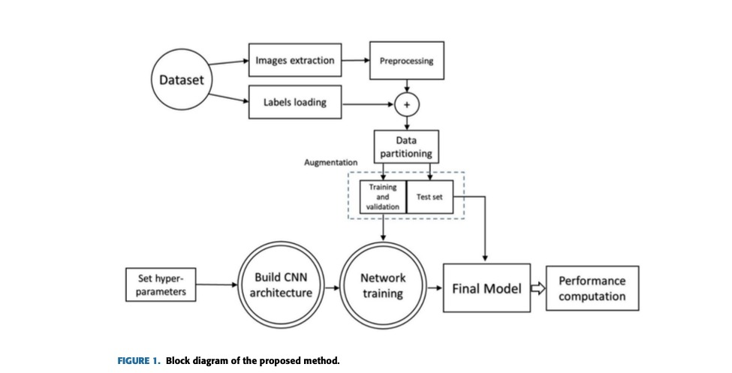
BLOCK DIAGRAM
Bangalore Institute of Technology
Dept. of ECE, BIT

Slide 15
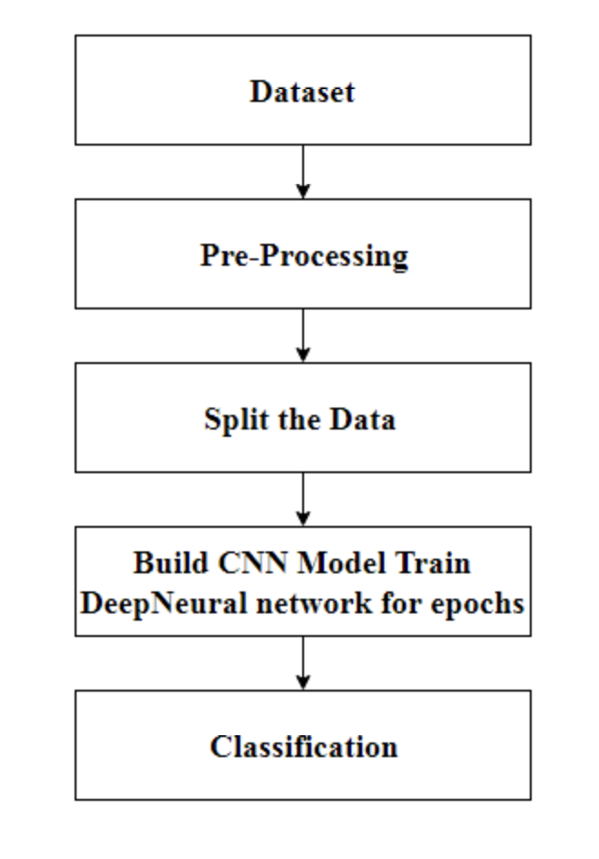
PROPOSED WORKFLOW
The proposed system has mainly five modules.
Dataset
Pre-processing,
Split the data,
Build CNN model train Deep Neural network for epochs
Classification
In dataset we can take multiple MRI images and take one as input image. In pre-processing image to encoded the label and resize the image. In split the data we set the image as 80% Training Data and 20% Testing Data. Then build CNN model train deep neural network for epochs. Then classified the image as yes or no if tumor is positive then it returns yes and the tumor is negative the it returns no.
Bangalore Institute of Technology
Dept. of ECE, BIT

Slide 16
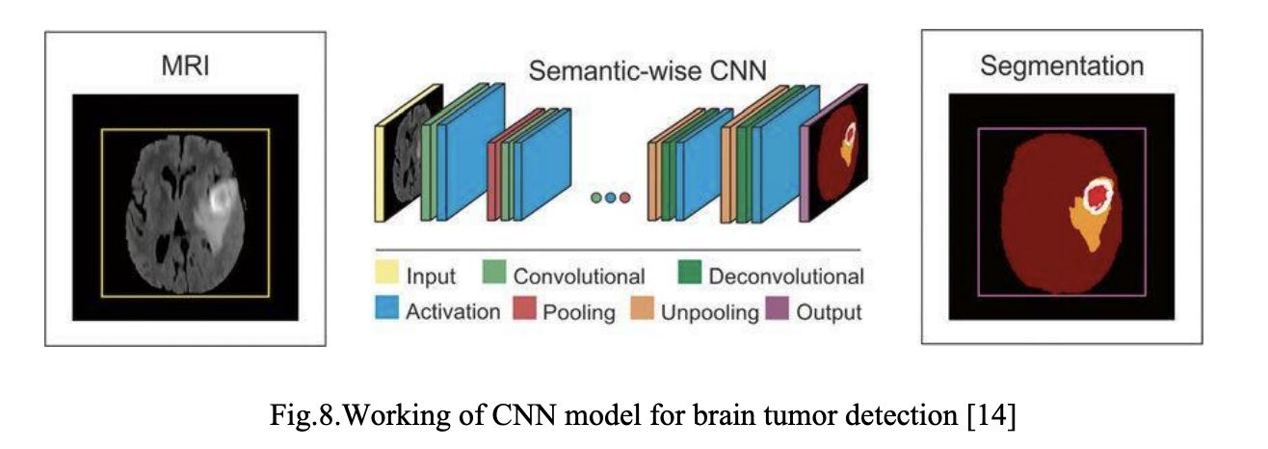
METHODOLOGY USED:
Bangalore Institute of Technology
Dept. of ECE, BIT

Slide 17
WORKING OF CNN MODEL:
Layer of CNN model:-
Convolution 2D
MAX Pooling 2D
Dropout
Flatten
Dense
Activation
Bangalore Institute of Technology
Dept. of ECE, BIT

Slide 18
WORKING OF CNN MODEL:
Convolution 2D: In the Convolution 2D extract the featured from input image. It given the output in matrix form.
MAX Pooling 2D: In the MAX polling 2D it take the largest element from rectified feature map.
Dropout: Dropout is randomly selected neurons are ignored during training.
Flatten: Flatten feed output into fully connected layer. It gives data in list form.
Bangalore Institute of Technology
Dept. of ECE, BIT

Slide 19
WORKING OF CNN MODEL:
Dense: A Linear operation in which every input is connected to every output by weight. It followed by nonlinear activation function
Activation: Sigmoid function and predict with probability 0 and 1.
In the compile model we used binary cross entropy because we have two layers 0 and 1.
We used Adam optimizer in compile model. Adam:-Adaptive moment estimation. It used for non convex optimization problem like straight forward to implement.
Computationally efficient.
Little memory requirement.
Bangalore Institute of Technology
Dept. of ECE, BIT

Slide 20






TOOLS USED
Brain tumor detection project uses the below libraries and frameworks:
Python
TensorFlow
Keras
Numpy
Scikit-learn
Matplotlib
OpenCV
Bangalore Institute of Technology
Dept. of ECE, BIT

Slide 21
PYTHON
Python was the language of selection for this project. This was a
straightforward call for many reasons.
1. Python as a language has a vast community behind it.
2. Python has an abundance of powerful tools prepared for scientific computing Packages like NumPy, Pandas and SciPy area unit freely available and well documented. Packages like these will dramatically scale back, and change the code required to write a given program.This makes iteration fast.
Bangalore Institute of Technology
Dept. of ECE, BIT

Slide 22
TENSORFLOW
TensorFlow is a free and open-source software library for machine learning and artificial intelligence. It can be used across a range of tasks but has a particular focus on training and inference of deep neural networks.
TensorFlow was developed by the Google Brain team for internal Google use in research and production. The initial version was released under the Apache License 2.0 in 2015. Google released the updated version of TensorFlow, named TensorFlow 2.0, in September 2019.
TensorFlow can be used in a wide variety of programming languages, including Python, JavaScript, C++, and Java. This flexibility lends itself to a range of applications in many different sectors.
Bangalore Institute of Technology
Dept. of ECE, BIT

Slide 23
KERAS
Keras is a deep learning API written in Python, running on top of the machine learning platform TensorFlow. It was developed with a focus on enabling fast experimentation.
It is:-
Simple -- but not simplistic. Keras reduces developer cognitive load to free you to focus on the parts of the problem that really matter.
Flexible -- Keras adopts the principle of progressive disclosure of complexity: simple workflows should be quick and easy, while arbitrarily advanced workflows should be possible via a clear path that builds upon what you've already learned.
Powerful -- Keras provides industry-strength performance and scalability: it is used by organizations and companies including NASA, YouTube, or Waymo.
Bangalore Institute of Technology
Dept. of ECE, BIT

Slide 24
NUMPY
NumPy is a general-purpose array-processing package. It provides a high-performance multidimensional array object, and tools for working with these arrays. It is the fundamental package for scientific computing with Python. It is open-source software. It contains various features including these important ones:
A powerful N-dimensional array object
Sophisticated (broadcasting) functions
Tools for integrating C/C++ and Fortran code
Useful linear algebra, Fourier transform, and random
number capabilities
Bangalore Institute of Technology
Dept. of ECE, BIT

Slide 25
OPENCV
OpenCV is the huge open-source library for the computer vision, machine learning, and image processing and now it plays a major role in real-time operation which is very important in today’s systems. By using it, one can process images and videos to identify objects, faces, or even handwriting of a human. When it integrated with various libraries, such as NumPy, python is capable of processing the OpenCV array structure for analysis. To Identify image pattern and its various features we use vector space and perform mathematical operations on these features.
Bangalore Institute of Technology
Dept. of ECE, BIT

Slide 26

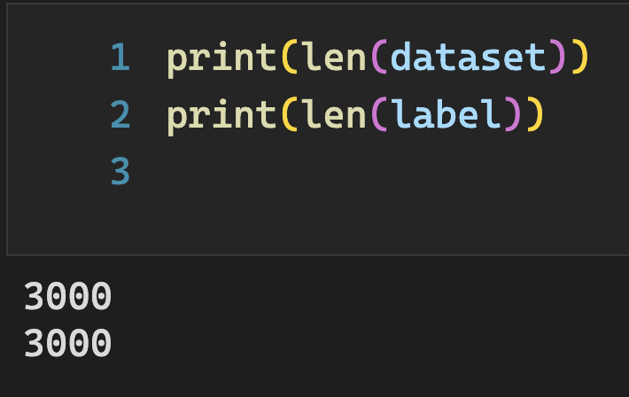
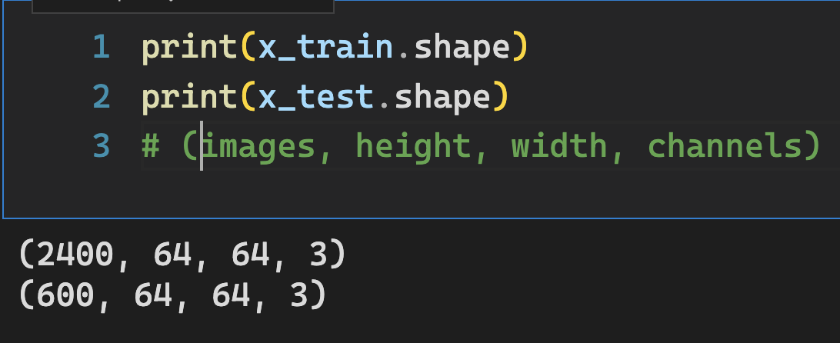
DATASETS
We will be using MRI scans dataset front the following website for extracting images for our model.
https://www.kaggle.com/datasets/navoneel/brain-mri-images-for-brain-tumor-detection
Bangalore Institute of Technology
Dept. of ECE, BIT

Slide 27
The predictions made by the model will be an array with each value being the probability that it predicts the image belongs to that category. So, we take the maximum of all such probabilities and assign the predicted label to that image input.
A confusion matrix is a matrix representation showing how well the trained model predicts each target class with respect to the counts. It contains 4 values in the following format:
EXPECTED OUTCOME
TP | FN
FP | TN
Bangalore Institute of Technology
Dept. of ECE, BIT

Slide 28
EXPECTED OUTCOME
True positive (TP): Target is positive and the model predicted it as positive
False negative (FN): Target is positive and the model predicted it as negative
False positive (FP): Target is negative and the model predicted it as positive
True negative (TN): Target is negative and the model predicted it as negative
Accuracy of the model = (TP + TN) / (TP + FN + FN + TN)
TP | FN
FP | TN
Bangalore Institute of Technology
Dept. of ECE, BIT

Slide 29
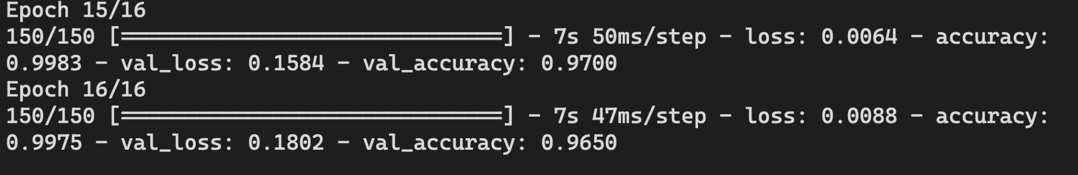
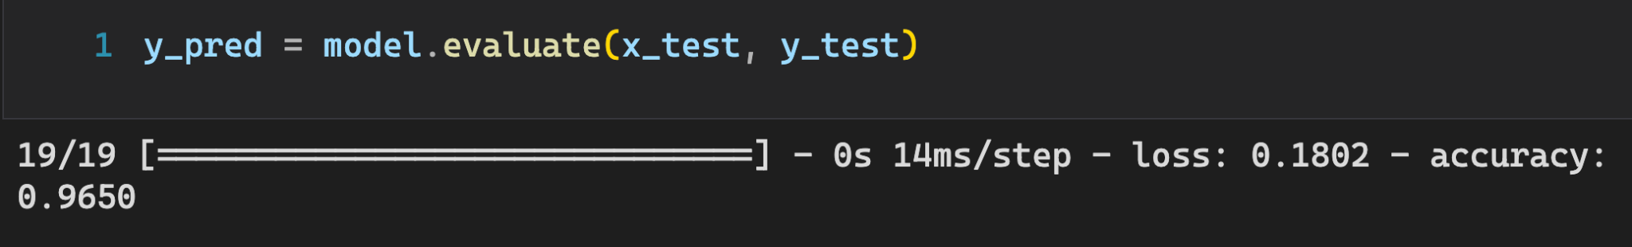
EXPECTED OUTCOME
ACCURACY AND LOSS DURING TRAINING OF MODEL
MODEL OVERALL ACCURACY
Bangalore Institute of Technology
Dept. of ECE, BIT

Slide 30
REFERENCES
Gurbină, M. Lascu and D. Lascu, “Tumor Detection and Classification of MRI Brain Image using Different Wavelet Transforms and Support Vector Machines”, 42nd International Conference on Telecommunications and Signal Processing (TSP), Budapest, Hungary, 2019
Somasundaram S and Gobinath R, “Early Brain Tumour Prediction using an Enhancement Feature Extraction Technique and Deep Neural Networks”, International Journal of Innovative Technology and Exploring Engineering (IJITEE), ISSN: 2278- 3075, Volume-8, Issue-10S, August 2019 .
G. Hemanth, M. Janardhan and L. Sujihelen, “Design and Implementing Brain Tumor Detection Using Machine Learning Approach”, 3rd International Conference on Trends in Electronics and Informatics (ICOEI), Tirunelveli, India, 2019.
J. Cheng, W. Huang, S. Cao, R. Yang, W. Yang, Z. Yun, Z. Wang, and Q. Feng, ‘‘Enhanced performance of brain tumor classification via tumor region augmentation and partition,’’ PloS ONE, vol. 10, no. 10, Oct. 2015, Art. no. e014038.
Bangalore Institute of Technology
Dept. of ECE, BIT

Slide 31
REFERENCES
5. S. Pereira, et al, Brain tumor segmentation using convolutional neural networks in MRI images, IEEE transactions on medical imaging, 35(5), pp. 1240-1251, 2016.
6. E. I. Zacharaki, S. Wang, S. Chawla, D. S. Yoo, R. Wolf, E. R. Melhem, and C. Davatzikos, ‘‘Classification of brain tumor type and grade using MRI texture and shape in a machine learning scheme,’’ Magn. Reson. Med., vol. 62, no. 6, pp. 1609–1618, Dec. 2009.
7. N. H. Rajini and R. Bhavani, ‘‘Classification of MRI brain images using nearest neighbor and artificial neural network,’’ in Proc. Int. Conf. Recent Trends Inf. Technol. (ICRTIT), Jun. 2011, pp. 563–568.
8. W. H. Ibrahim, A. A. A. Osman, and Y. I. Mohamed, ‘‘MRI brain image classification using neural networks,’’ in Proc. Int. Conf. Comput., Electr. Electron. Eng. (ICCEEE), Aug. 2013, pp. 253–258.
Bangalore Institute of Technology
Dept. of ECE, BIT

Slide 32
REFERENCES
9. Avigyan Sinha , Aneesh R P , Malavika Suresh , Nitha Mohan R, Abinaya D, Ashwin G Singerji Brain Tumour Detection Using Deep Learning (2019) IEEE Conference(ICCEEE), 2019,Aug. 2013, pp. 253–258.
10. Masoumeh Siar,Mohammad Teshnehlab "Brain Tumor Detection Using Deep Neural Network and Machine Learning Algorithm", 9th International Conference on Computer and Knowledge Engineering (ICCKE 2019), October 24-25 2019, Ferdowsi University of Mashhad.
Bangalore Institute of Technology
Dept. of ECE, BIT

Slide 33

THANK YOU
Bangalore Institute of Technology
Dept. of ECE, BIT

